Slide 1
Running SQL Server 2019 in Docker Containers
Bogdan Mortu, SQL Developer
Bucharest • 22 April 2019

Slide 2

Agenda
Containers – some theory
Building your first container
Creating a custom container image
Exporting a custom image
Pushing custom image to Docker Hub

Slide 3
What is a container?
A Docker container is a:
- lightweight, standalone, executable package of software that
- includes everything needed to run an application (code, runtime, system tools, system libraries and settings)
- in an isolated manner as regards the host system.
They are:
- easy to deploy
- easy to customize
- easy to share
Similar in a way, but Docker is not a VM !!!!

Slide 4
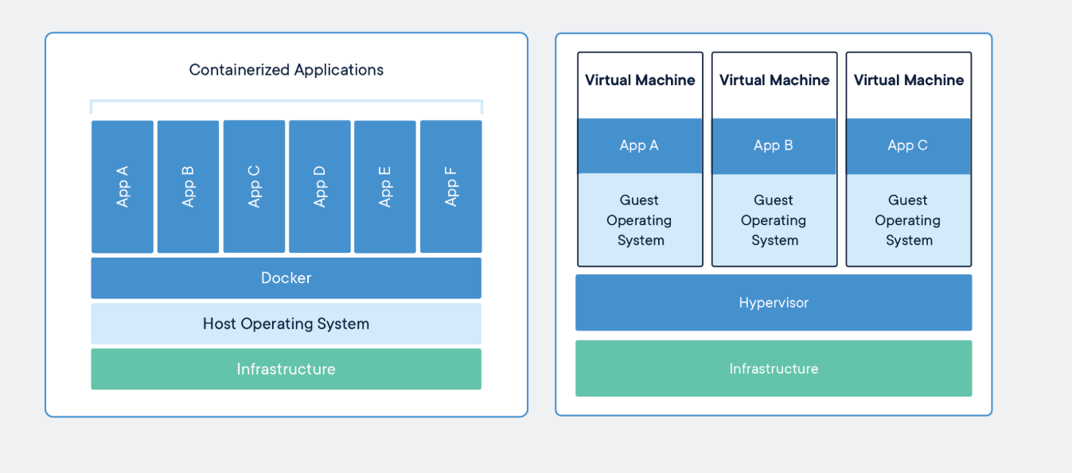
Are Containers Replacing Virtual Machines ?

Slide 5
Containers – pros and cons
Pros
Simple and fast setup
New containers can be spun up in seconds
Relatively low footprint as compared to VMs
Ability to customise images
Free access to Docker repository (hundreds of images available)
Portability – images can be saved to the Docker Hub
Cons
Only dabatase engine is running
No Server Agent, SSIS, SSAS & SSRS

Slide 6
Containers – some usefull terminology and commands
Terminology
Container HOST
Container ENGINE
Container REGISTRY
Container IMAGES
Commands
docker search
docker pull
docker images
docker run
docker ps
docker inspect
docker logs
docker stop
docker start
docker push
docker rm
docker rmi

Slide 7
DEMO

Slide 8
Thank you

